Slide 1


Epidemic Models L6 Linking models to data – Estimating R₀
Andrew J K Conlan
University of Cambridge
ajkc2@cam.ac.uk
The Møller Institute, Cambridge, September 4th -11th 2022

Slide 2
Even simple models depend on parameters that we do not directly observe
Per capita birth rate
Transmission Rate
Infectious Period
Case Reports
Serological Surveys
Contact Tracing

Slide 3

Likelihood based inference
Gold standard methods for model estimation
Estimation for dynamic models is hard
Likelihoods often:
Depend on information we do not have
Are computationally intractable for complex models
Estimate parameters indirectly through simpler models and summary statistics

Slide 4
If we can estimate R₀ from a simple model we have a starting point to build and compare more complex models
Maximum eigenvalue
of the Next Generation
Matrix

Slide 5
Re-using estimates of R₀
Although R₀ is conceptually model independent, the value of R₀ can be quite different for models based on different assumptions
In particular the estimated value of R₀ can be misleading when there is a mismatch of assumptions between:
The statistical model and the dynamic model
The model and reality!

Slide 6
Outbreak in a boarding school
Population of 1,300
Outbreak of new disease “Outfluenza” with new cases reported daily

Slide 7
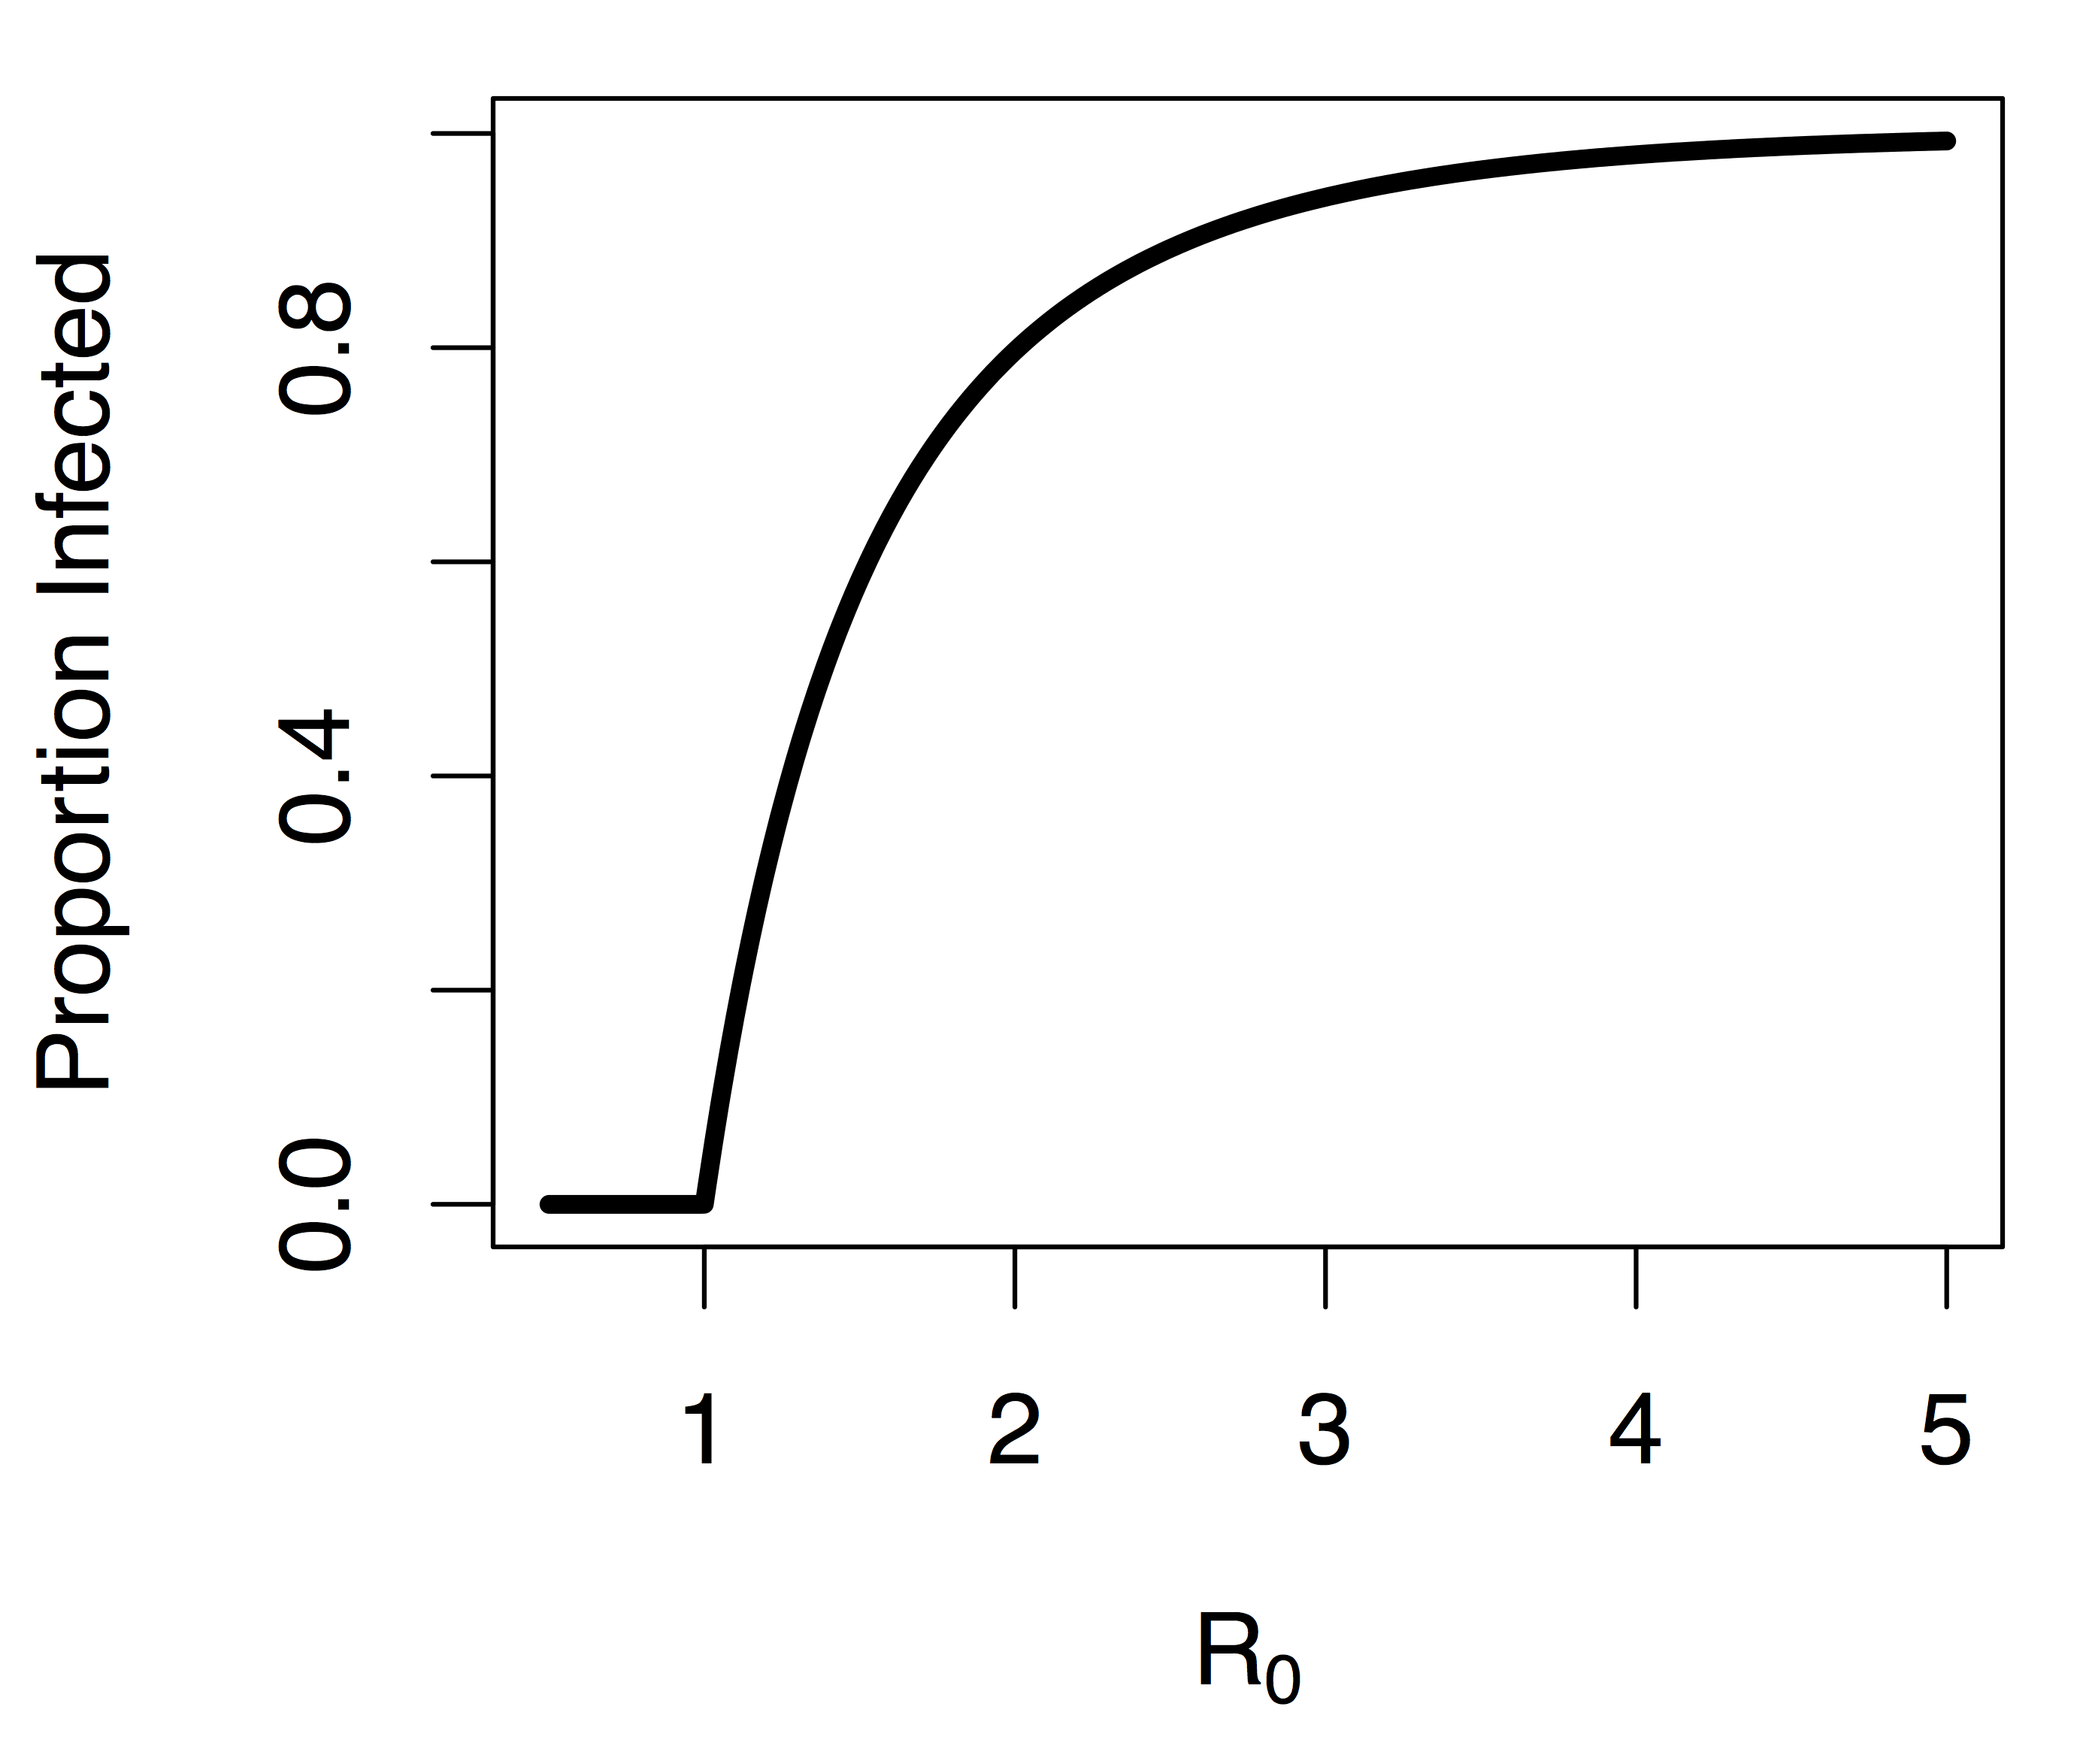
In closed populations can define final size of epidemic

Slide 8
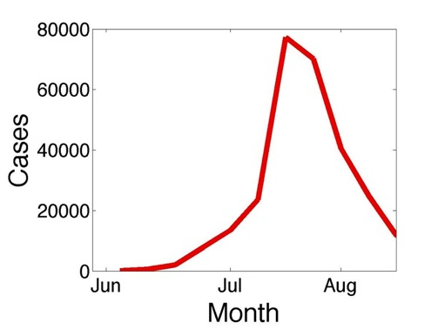
Initial growth of epidemic is approximately exponential
Exponential growth in cases
Exponential rate depends on
R₀ and T_{I}

Slide 9
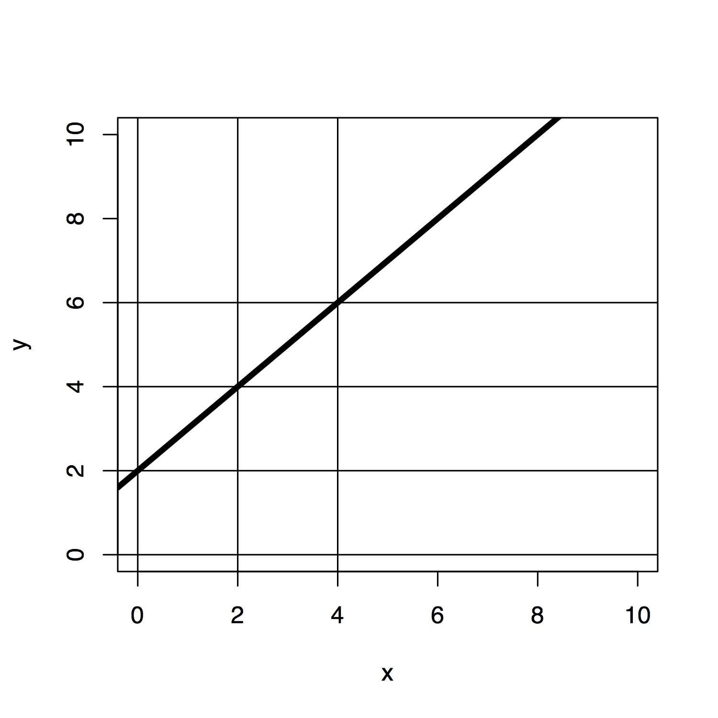
Exponential growth model is much easier to estimate…
Approximate the epidemic model with a simpler statistical model that we know how to fit

Slide 10
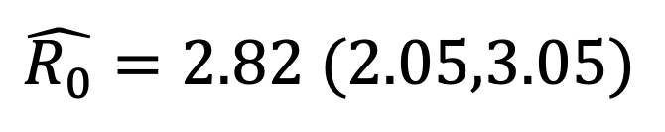
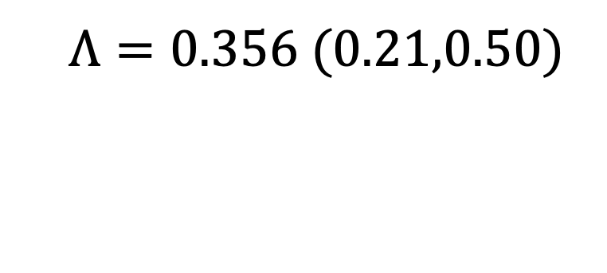

Outfluenza: R₀=2.5, $T_{I}=5$ days
Expect exponential growth in I
at early stages of epidemic
$$Λ=0.356 (0.21,0.50)$$
$$\hat{R_{0}}=2.82 (2.05,3.05)$$

Slide 11
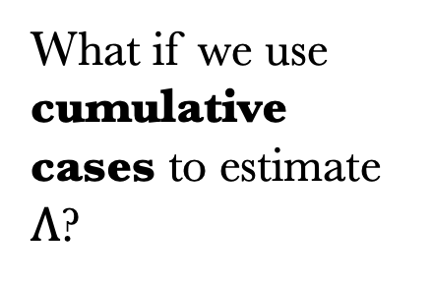
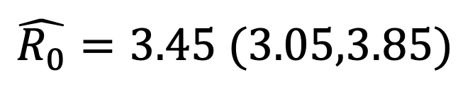
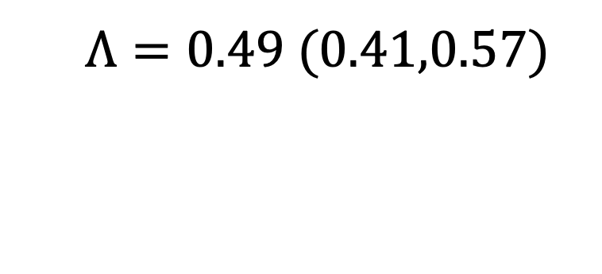
Outfluenza: R₀=2.5, $T_{I}=5$ days
What if we use cumulative cases to estimate $Λ$?
$$Λ=0.49 (0.41,0.57)$$
$$\hat{R_{0}}=3.45 (3.05,3.85)$$
Estimate is higher
and less variable…

Slide 12
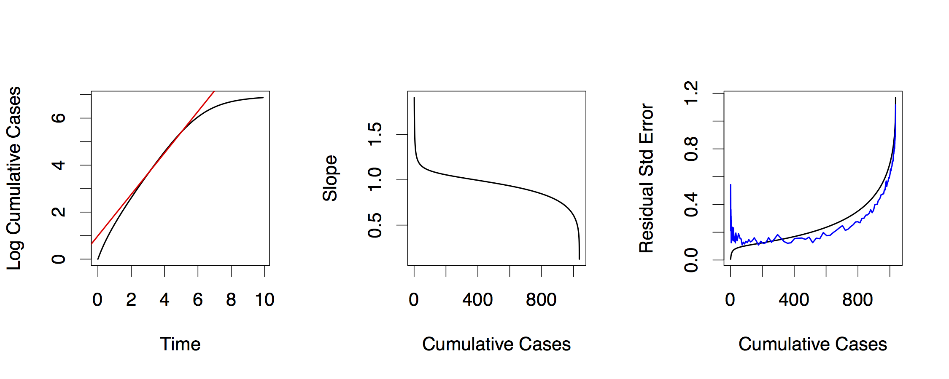
Identifying the exponential phase…
Estimate of slope is sensitive to range of time-points we use (first 100 cases)
Too few time points may overestimate R₀
Too many time points may underestimate R₀

Slide 13
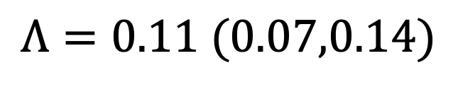
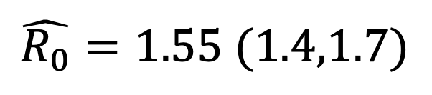
Biggles: R₀ = 2.5, T_{E} = 5, T_{I} = 5
$$Λ=0.11 (0.07,0.14)$$
$$\hat{R_{0}}=1.55 (1.4,1.7)$$
?

Slide 14
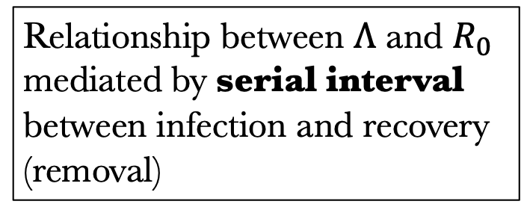
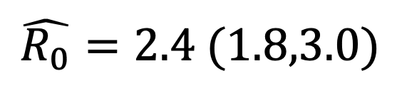
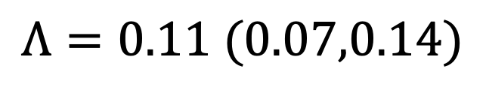
Biggles: R₀ = 2.5, T_{E} = 5, T_{I} = 5
E
$$Λ=0.11 (0.07,0.14)$$
I
$$\hat{R_{0}}=2.4 (1.8,3.0)$$
Relationship between $Λ$ and $R_{0}$
mediated by serial interval
between infection and recovery
(removal)

Slide 15
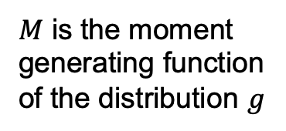
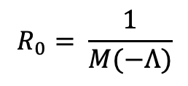
Estimates of R₀ are model dependent
SIR model
SEIR model
γ-SEIR model
$$R_{0}= \frac{1}{M(−Λ)}$$
$M$ is the moment
generating function
of the distribution $g$
Wallinga and Lipsitch Proc. R. Soc. B (2007) 274, 599–604
Vynnycky and White (2010)

Slide 16

It’s dangerous to go alone…
Epidemic Growth Rate
earlyR
Renewal Equation Methods
EpiEstim
EpiNow2
Trajectory Matching
pomp
LibBi, Birch
Odin, Dust, mcmcstate
Turing.jl
Gostic KM et al. (2022) PLoS Comput Biol 16(12): e1008409

Slide 17
What if the disease is already endemic?
Household data
Age patterns
Mean age at first infection
Force of infection
Who Acquires Infection from Whom?

Slide 18
Estimating R₀ for endemic diseases
For endemic diseases a first estimate of R₀ is provided by the mean age at first infection (A) and mean life expectancy (L):
This first estimate assumes that the (average) risk of acquiring infection (per unit time) λ is constant with age
λ is commonly referred to as the force of infection

Slide 19
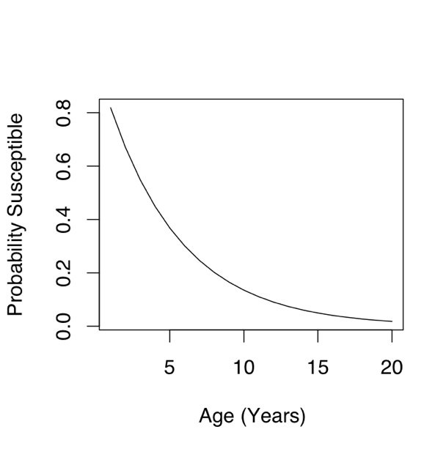
Catalytic Model
Serological surveys measure proportion immune
To compare to case reports need fraction of cases reported between age a₀ and a₁:
Probability Susceptible
at age a:

Slide 20
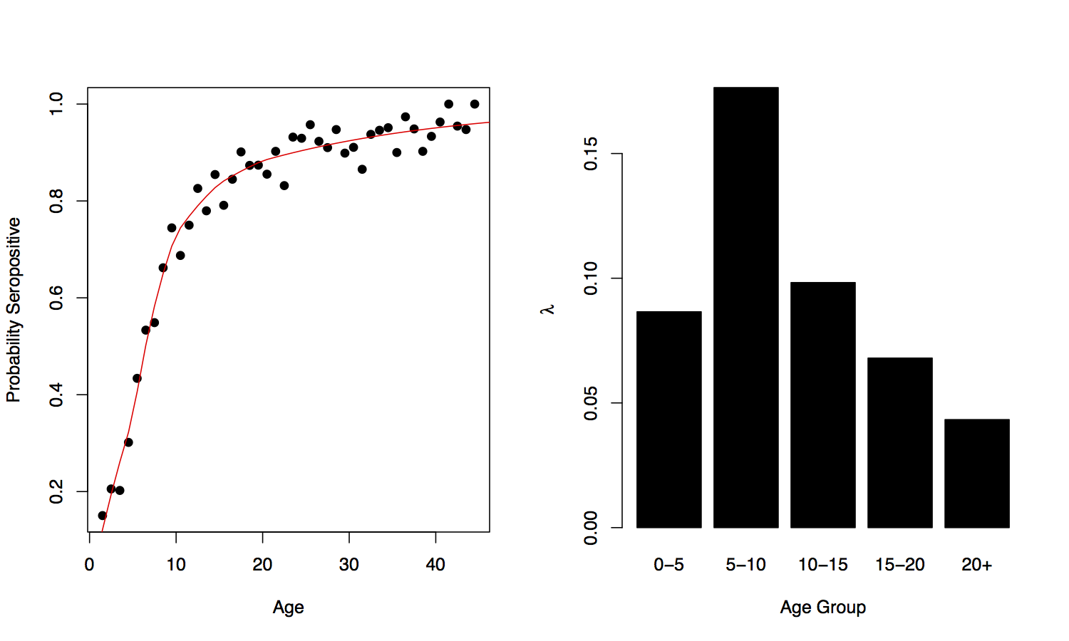
UK Rubella Serology (1984)
Morgan-Capner et al. 1988

Slide 21
Assume that force of infection is constant within discrete age-groups
Within each age-group the proportion
susceptible decays according to
Catalytic model

Slide 22
First Estimate of Force of Infection
Serological survey measures proportion immune
Solve for λ

Slide 23
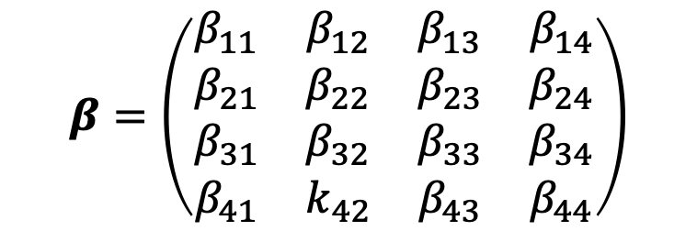
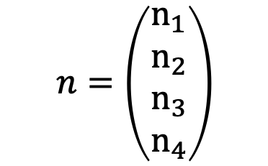
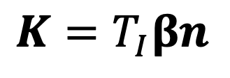
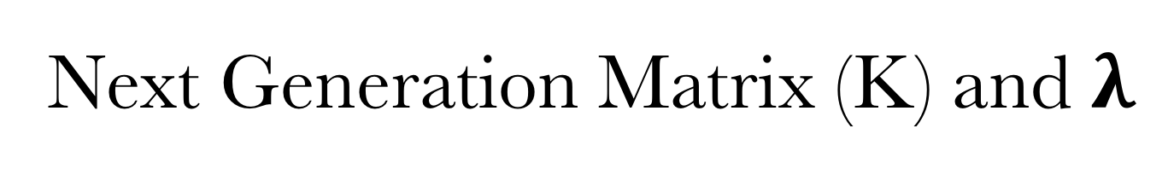
Next Generation Matrix (K) and $λ$
But, force of infection alone is not enough to estimate R₀
Recall R₀ is maximum eigenvalue of next generation matrix K
$$K=T_{I}βn$$
$$β=\left(\begin{matrix}β_{11} & β_{12} & β_{13} & β_{14} \\ β_{21} & β_{22} & β_{23} & β_{24} \\ β_{31} & β_{32} & β_{33} & β_{34} \\ β_{41} & k_{42} & β_{43} & β_{44}\end{matrix}\right)$$
$$n=\left(\begin{matrix}n_{1} \\ n_{2} \\ n_{3} \\ n_{4}\end{matrix}\right)$$
Infectious period
Transmission rate between (and within) each age group
Proportion in each age group

Slide 24
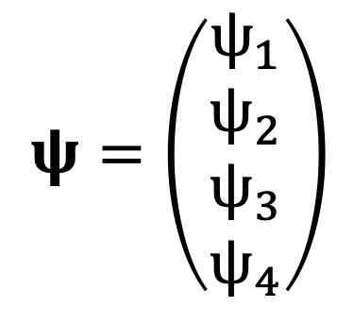
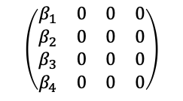
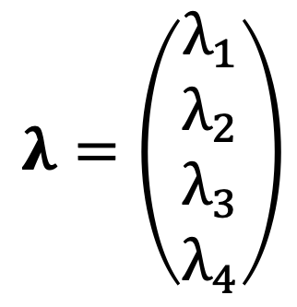
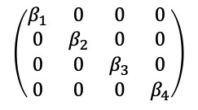
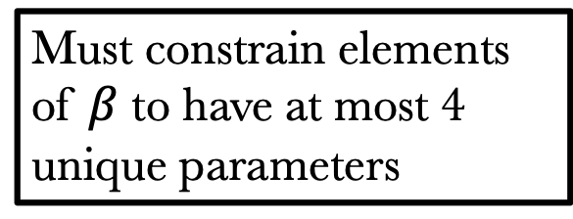
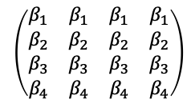
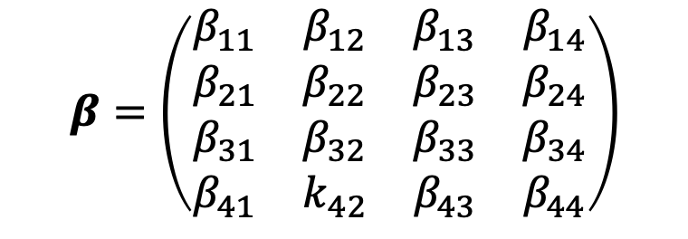
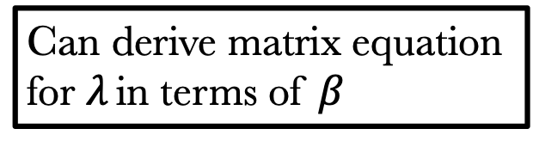
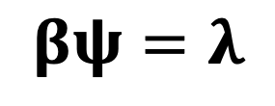
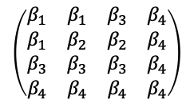
Next Generation Matrix (K) and $λ$
$$β=\left(\begin{matrix}β_{11} & β_{12} & β_{13} & β_{14} \\ β_{21} & β_{22} & β_{23} & β_{24} \\ β_{31} & β_{32} & β_{33} & β_{34} \\ β_{41} & k_{42} & β_{43} & β_{44}\end{matrix}\right)$$
Can derive matrix equation for $λ$ in terms of $β$
$$βψ=λ$$
Must constrain elements of $β$ to have at most 4 unique parameters
$$λ=\left(\begin{matrix}λ_{1} \\ λ_{2} \\ λ_{3} \\ λ_{4}\end{matrix}\right)$$
$$ψ=\left(\begin{matrix}ψ_{1} \\ ψ_{2} \\ ψ_{3} \\ ψ_{4}\end{matrix}\right)$$
$$\left(\begin{matrix}β_{1} & β_{1} & β_{1} & β_{1} \\ β_{2} & β_{2} & β_{2} & β_{2} \\ β_{3} & β_{3} & β_{3} & β_{3} \\ β_{4} & β_{4} & β_{4} & β_{4}\end{matrix}\right)$$
$$\left(\begin{matrix}β_{1} & 0 & 0 & 0 \\ 0 & β_{2} & 0 & 0 \\ 0 & 0 & β_{3} & 0 \\ 0 & 0 & 0 & β_{4}\end{matrix}\right)$$
Force of infection in each age group
Proportion of each age group infected per unit time
$$\left(\begin{matrix}β_{1} & 0 & 0 & 0 \\ β_{2} & 0 & 0 & 0 \\ β_{3} & 0 & 0 & 0 \\ β_{4} & 0 & 0 & 0\end{matrix}\right)$$
$$\left(\begin{matrix}β_{1} & β_{1} & β_{3} & β_{4} \\ β_{1} & β_{2} & β_{2} & β_{4} \\ β_{3} & β_{3} & β_{3} & β_{4} \\ β_{4} & β_{4} & β_{4} & β_{4}\end{matrix}\right)$$
N equations in N x N unknowns…

Slide 25
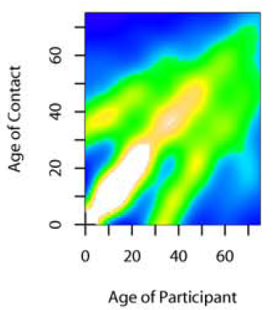
Social contact networks and transmission
Social networks have now been measured using a variety of different instruments
Contact diaries - Mossong et al, PLoS Med 2008
Wearable sensors – Barrat et al. Clinical Microbiology and Infection 2014
Mobile phone data - Wesolowski et al. Journal of Infectious Diseases 2017
Mossong et al, PLoS Med 2008

Slide 26
Next Estimate, and R₀
For given K can calculate corresponding λ and P_{s}(a)
Alternatively can estimate next generation matrix directly…
Modelling Infectious Disease Parameters Based on Serological and Social Contact Data
Hens et al. 2012

Slide 27
Summary
Basic methods to estimate R₀
Final Epidemic Size
Rate of exponential growth of new cases
Renewal Methods
Mean Age at First Infection
Next Generation Matrix
Simpler statistical (or even static) models can be used to inform parameters for more complex dynamic models

